Slide 1
Online Role-based training resources: Microsoft Learn https://docs.microsoft.com/en-us/learn/

Slide 2
Module 6: Optimize Model Performance

Slide 3
Learning Objectives
You will learn the following concepts:
Data model performance optimization
DirectQuery model optimization
Notes:
By the end of this module, you’ll be able to:
Optimize the data model for performance
Optimize DirectQuery models

Slide 4
Module Agenda
Optimize the Data Model for Performance
Identify poorly performing measures, relationships, and visuals
Reduce cardinality levels to improve performance

Slide 5
Lesson 1: Optimize the Data Model for Performance

Slide 6
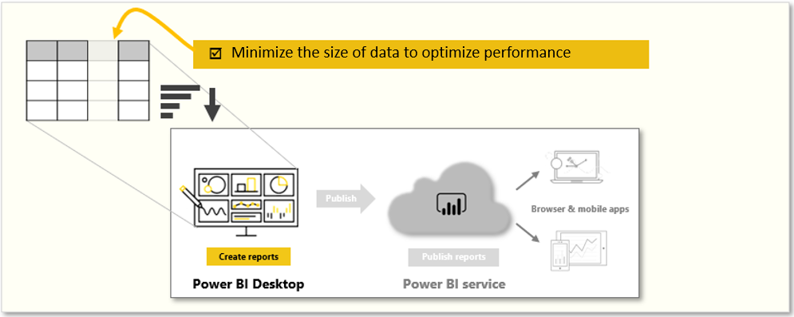
Introduction to Performance Optimization
When your data model is optimized, it performs better.
Notes:
Performance optimization, also known as performance tuning, involves making changes to the current state of the data model so that it runs more efficiently. Essentially, when your data model is optimized, it performs better.
You might find that your report runs well in test and development environments, but when deployed to production for broader consumption, performance issues arise. From a report user's perspective, poor performance is characterized by report pages that take longer to load and visuals taking more time to update. This poor performance results in a negative user experience.
As a data analyst, you will spend approximately 90 percent of your time working with your data, and nine times out of ten, poor performance is a direct result of a bad data model, bad Data Analysis Expressions (DAX), or the mix of the two. The process of designing a data model for performance can be tedious, and it is often underestimated.
A smaller sized data model uses less resources (memory) and achieves faster data refresh, calculations, and rendering of visuals in reports. Therefore, the performance optimization process involves minimizing the size of the data model and making the most efficient use of the data in the model, which includes:
Ensuring that the correct data types are used.
Deleting unnecessary columns and rows.
Avoiding repeated values.
Replacing numeric columns with measures.
Reducing cardinalities.
Analyzing model metadata.
Summarizing data where possible.
In this module, you will be introduced to the steps, processes, and concepts that are necessary to optimize a data model for enterprise-level performance.

Slide 7
Use Variables to Improve Performance and Troubleshooting
Without variable:
Sales YoY Growth =
DIVIDE (
( [Sales] - CALCULATE ( [Sales], PARALLELPERIOD ( 'Date'[Date], -12, MONTH ) ) ),
CALCULATE ( [Sales], PARALLELPERIOD ( 'Date'[Date], -12, MONTH ) )
)
With variable:
Sales YoY Growth =
VAR SalesPriorYear =
CALCULATE ( [Sales], PARALLELPERIOD ( 'Date'[Date], -12, MONTH ) )
VAR SalesVariance =
DIVIDE ( ( [Sales] - SalesPriorYear ), SalesPriorYear )
RETURN
SalesVariance
Notes:
You can use variables in your DAX formulas to help you write less complex and more efficient calculations. Variables are underused by developers who are starting out in Power BI Desktop, but they are effective and you should use them by default when you are creating measures.
Some expressions involve the use of many nested functions and the reuse of expression logic. These expressions take a longer time to process and are difficult to read and, therefore, troubleshoot. If you use variables, you can save query processing time. This change is a step in the right direction toward optimizing the performance of a data model.
The use of variables in your data model provides the following advantages:
Improved performance - Variables can make measures more efficient because they remove the need for Power BI to evaluate the same expression multiple times. You can achieve the same results in a query in about half the original processing time.
Improved readability - Variables have short, self-describing names and are used in place of an ambiguous, multi-worded expression. You might find it easier to read and understand the formulas when variables are used.
Simplified debugging - You can use variables to debug a formula and test expressions, which can be helpful during troubleshooting.
Reduced complexity - Variables do not require the use of EARLIER or EARLIEST DAX functions, which are difficult to understand. These functions were required before variables were introduced, and were written in complex expressions that introduced new filter contexts. Now that you can use variables instead of those functions, you can write fewer complex formulas.
Use variables to improve performance
To illustrate how you can use a variable to make a measure more efficient, let’s take a look an expression that calculates “the same period last year”, but in two different ways. The first instance uses the normal DAX calculation method…
<CLICK>
But the second one uses variables in the calculation.
Use variables to improve readability
In addition to improved performance, you might notice how the use of variables makes the code simpler to read.
Use variables to troubleshoot multiple steps
You can use variables to help you debug a formula and identify what the issue is. Variables help simplify the task of troubleshooting your DAX calculation by evaluating each variable separately and by recalling them after the RETURN expression.

Slide 8
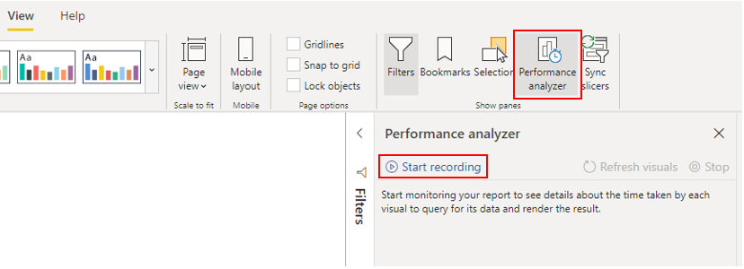
Performance Analyzer
Find out how each report element is performing.
Measure report elements during user interaction.
Detect which aspects are least or most resource intensive.
Notes:
If your data model has multiple tables, complex relationships, intricate calculations, multiple visuals, and redundant data, a potential exists for poor report performance. The poor performance of a report leads to a negative user experience.
To optimize performance, you must first identify where the problem is coming from; in other words, find out which elements of your report and data model are causing the performance issues. Afterward, you can take action to resolve those issues and, therefore, improve performance.
Identify report performance bottlenecks
To achieve optimal performance in your reports, you need to create an efficient data model that has fast running queries and measures. When you have a good foundation, you can improve the model further by analyzing the query plans and dependencies and then making changes to further optimize performance.
Analyze performance
You can use Performance analyzer in Power BI Desktop to help you find out how each of your report elements are performing when users interact with them.
To begin the analysis process, select Start recording, select the page of the report that you want to analyze, and interact with the elements of the report that you want to measure. You will see the results of your interactions display in the Performance analyzer pane as you work. When you are finished, select the Stop button.

Slide 9
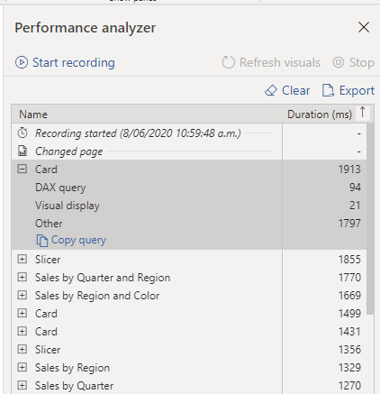
Review Performance Results
Log information shows duration to complete each task.
Duration value indicates the difference between the start and end timestamp for each operation.
Notes:
You can review the results of your performance test in the Performance analyzer pane. To review the tasks in order of duration, longest to shortest, right-click the Sort icon next to the Duration (ms) column header, and then select Total time in Descending order.
The log information for each visual shows how much time it took (duration) to complete the following categories of tasks:
DAX query - The time it took for the visual to send the query, along with the time it took Analysis Services to return the results.
Visual display - The time it took for the visual to render on the screen, including the time required to retrieve web images or geocoding.
Other - The time it took the visual to prepare queries, wait for other visuals to complete, or perform other background processing tasks. If this category displays a long duration, the only real way to reduce this duration is to optimize DAX queries for other visuals, or reduce the number of visuals in the report.
The results of the analysis test help you to understand the behavior of your data model and identify the elements that you need to optimize. You can compare the duration of each element in the report and identify the elements that have a long duration. You should focus on those elements and investigate why it takes them so long to load on the report page.
Metadata
Metadata is information about other data. Power BI metadata contains information on your data model, such as the name, data type and format of each of the columns, the schema of the database, the report design, when the file was last modified, the data refresh rates, and much more.
You can use Power Query Editor in Power BI Desktop to examine the columns, rows, and values of the raw data. You can then use the available tools, such as those highlighted in the following screenshot, to make the necessary changes.

Slide 10


Analyze Query Plans
Count Customers =
CALCULATE ( DISTINCTCOUNT ( Order[ProductID] ), FILTER ( Order, Order[OrderQty] >= 5 ) )
Count Customers =
CALCULATE ( DISTINCTCOUNT ( Order[ProductID] ), KEEPFILTERS (Order[OrderQty] >= 5 ) )
Notes:
When you examine the results in the Performance analyzer pane, you can see how long it took the Power BI Desktop engine to evaluate each query (in milliseconds). A good starting point is any DAX query that is taking longer than 120 milliseconds. In this example, you identify one particular query that has a large duration time.
Performance analyzer highlights potential issues but does not tell you what needs to be done to improve them. You might want to conduct further investigation into why this measure takes so long to process. You can use DAX Studio to investigate your queries in more detail.
In this example, you are trying to count the total number of products with order quantities greater than or equal to five.
After analyzing the query, you can use your own knowledge and experience to identify where the performance issues are. In the following example, after some debugging, you replace the FILTER function with the KEEPFILTER function.
<CLICK>
When the test was run again in Performance analyzer, the duration was shorter as a result of the KEEPFILTER function.
In this case, you can replace the FILTER function with the KEEPFILTER function to significantly reduce the evaluation duration time for this query. When you make this change, to check whether the duration time has improved or not, clear the data cache and then rerun the Performance analyzer process.

Slide 11
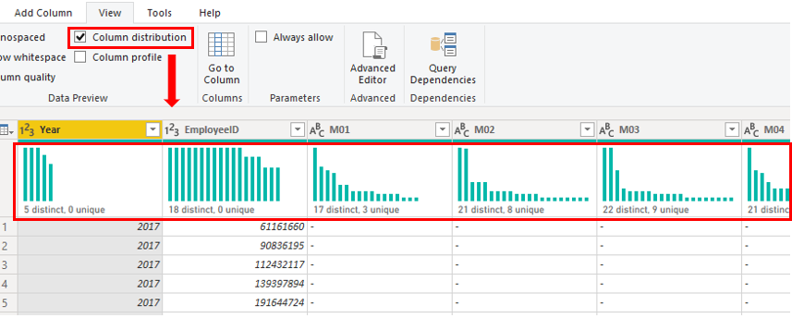
Reduce Cardinality
Notes:
Reduce Cardinality
Cardinality is a term that is used to describe the uniqueness of the values in a column. Cardinality is also used in the context of the relationships between two tables, where it describes the direction of the relationship.
Identify cardinality levels in columns
Previously, when you used Power Query Editor to analyze the metadata, the Column distribution option on the View tab displayed statistics on how many distinct and unique items were in each column in the data.
Distinct values count - The total number of different values found in a given column.
Unique values count - The total number of values that only appear once in a given column.
A column that has a lot of repeated values in its range (distinct count is high) will have a low level of cardinality. Conversely, a column that has a lot of unique values in its range (unique count is high) will have a high level of cardinality.
Lower cardinality leads to more optimized performance, so you might need to reduce the number of high cardinally columns in your dataset.
Reduce relationship cardinality
When you import multiple tables, it is possible that you'll do some analysis by using data from all those tables. Relationships between those tables are necessary to accurately calculate results and display the correct information in your reports.
Improve performance by reducing cardinality levels
Power BI Desktop offers different techniques that you can use to help reduce the data that is loaded into data models, such as summarization. Reducing the data that is loaded into your model will improve the relationship cardinality of the report. For this reason, it is important that you strive to minimize the data that will be loaded into your models. This case is especially true for large models, or models that you anticipate will grow to become large over time.
Perhaps the most effective technique to reduce a model size is to use a summary table from the data source. Where a detail table might contain every transaction, a summary table would contain one record per day, per week, or per month. It might be an average of all of the transactions per day, for instance.
An effective technique to reduce the model size is to set the Storage Mode property for larger fact-type tables to DirectQuery.

Slide 12
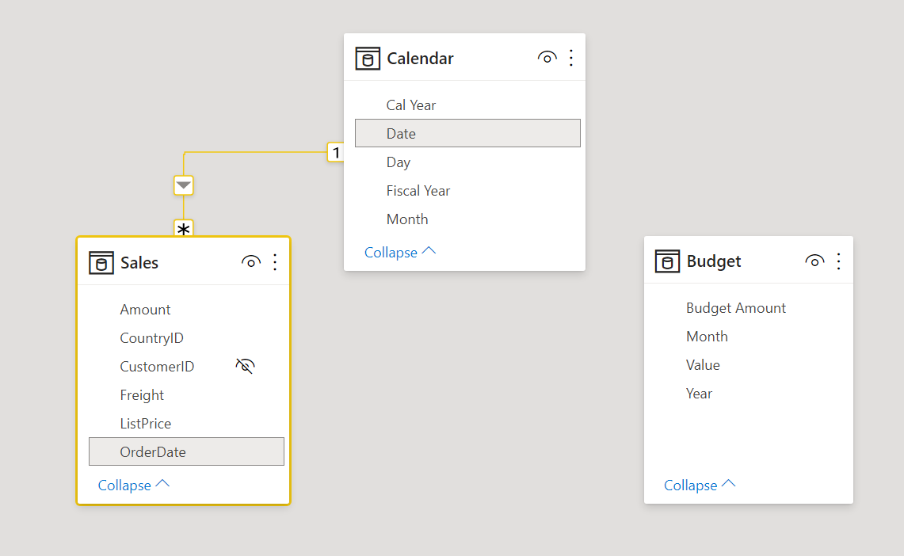
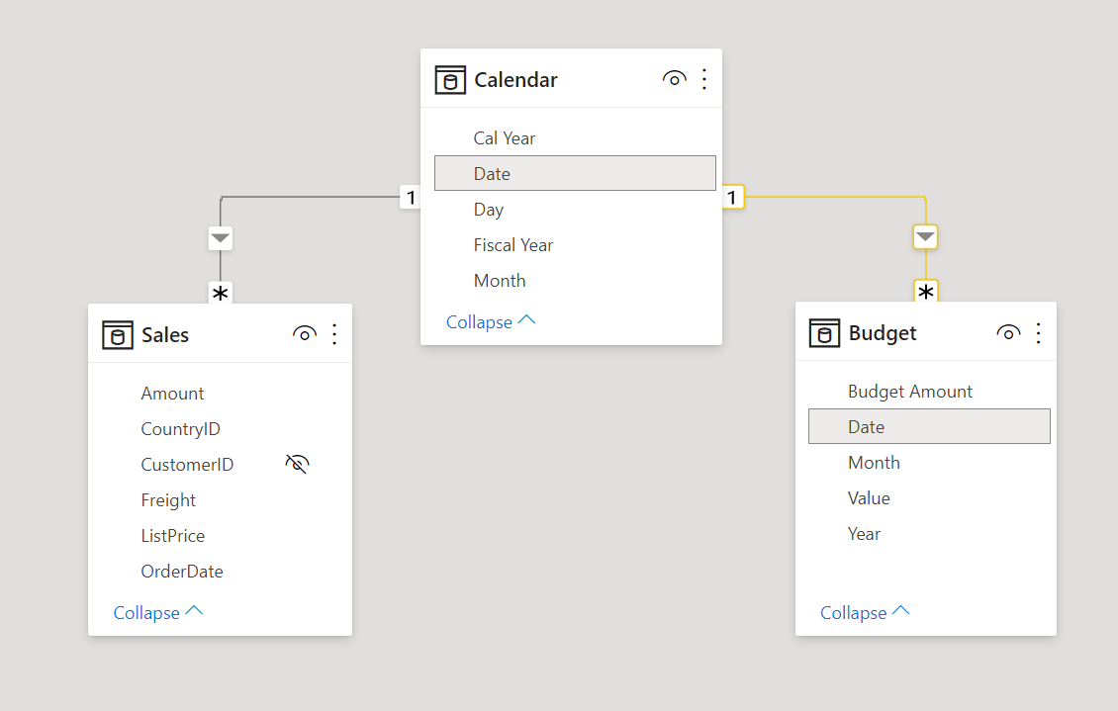
Implement Table Granularity
Granularity: The lowest level that data can be in a set of data.
Notes:
Data granularity is the detail that is represented within your data, meaning that the more granularity your data has, the greater the level of detail within your data.
Data granularity is an important topic for all data analysts, regardless of the Power BI tools that you are using. Defining the correct data granularity can have a big impact on the performance and usability of your Power BI reports and visuals.
Refrigerated Truck example. 1000’s of trucks sending current temperature, extensive data is generated. How can you change the granularity of the data to make the dataset more usable?
Change relationship granularity
Data granularity can also have an impact when you are building relationships between tables in Power BI.
You have been asked to build a matrix of total sales and budget over time by using the Calendar, Sales, and Budget tables. You notice that the lowest level of time-based detail that the Sales table goes into is by day, for instance 5/1/2020, 6/7/2020, and 6/18/2020. The Budget table only goes to the monthly level, for instance, the budget data is 5/2020 and 6/2020.
These tables have different granularities that need to be reconciled before you can build a relationship between tables, and a relationship between Budget and Calendar is missing.
How?
Transform the Year and Month columns in the Budget table (concatenate year and month), you can match the format of the Date column in the Calendar table.
Establish a relationship between the two tables.
Insert the column into the Budget table.
By completing this task, you have ensured that the granularity is the same between your different tables.

Slide 13
Review Questions
Q01 – What benefit do you get from analyzing metadata?
A01 – The benefit of analyzing metadata is that you can clearly identify data inconsistencies with your dataset.
Q02 – Which tool enables you to identify bottlenecks that exist in code?
A02 – Performance Analyzer
Q03 – What is cardinality?
A03 – The direction that the data flows in a relationship between tables.

Slide 14
Lesson 2: Optimize DirectQuery Models

Slide 15
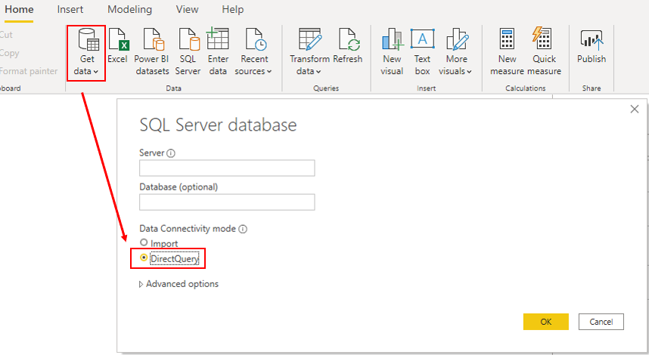
Introduction to DirectQuery
Connect directly to your data source repository.
Notes:
DirectQuery is one way to get data into Power BI Desktop. The DirectQuery method involves connecting directly to data in its source repository from within Power BI Desktop. It is an alternative to importing data into Power BI Desktop.
When you use the DirectQuery method, the overall user experience depends heavily on the performance of the underlying data source. Slow query response times will lead to a negative user experience and, in the worst-case scenarios, queries might time out. Also, the number of users who are opening the reports at any one time will impact the load that is placed on the data source. For example, if your report has 20 visuals in it and 10 people are using the report, 200 queries or more will exist on the data source because each visual will issue one or more queries.
Unfortunately, the performance of your Power BI model will not only be impacted by the performance of the underlying data source, but also by other uncontrollable factors, such as:
Network latency; faster networks return data quicker.
The performance of the data source's server and how many other workloads are on that server. For example, consider the implications of a server refresh taking place while hundreds of people are using the same server for different reasons.
Therefore, using DirectQuery poses a risk to the quality of your model's performance. To optimize performance in this situation, you need to have control over, or access to, the source database.

Slide 16
Implications of using DirectQuery
Benefits:
Where data changes frequently.
Near-real time reporting is needed.
Supports large data volumes.
Supports multi-dimensional data.
Limitations:
Performance: Depends on the underlying data source.
Security: Understand how data moves between source and destination.
Modeling: Some modeling capabilities are limited or aren’t supported.
Transformation: Some data transformation techniques are limited.
Notes:
It is best practice to import data into Power BI Desktop, but your organization might need to use the DirectQuery data connectivity mode.
If your organization needs to use DirectQuery, you should clearly understand its behavior within Power BI Desktop and be aware of its limitations. You will then be in a good position to take action to optimize the DirectQuery model as much as possible.
When you use DirectQuery to connect to data in Power BI Desktop, that connection behaves in the following way:
When you initially use the Get Data feature in Power BI Desktop, you will select the source. If you connect to a relational source, you can select a set of tables and each one will define a query that logically returns a set of data. If you select a multidimensional source, such as SAP BW, you can only select the source.
When you load the data, no data is imported into the Power BI Desktop, only the schema is loaded. When you build a visual within Power BI Desktop, queries are sent to the underlying source to retrieve the necessary data. The time it takes to refresh the visual depends on the performance of the underlying data source.
If changes are made to the underlying data, they won't be immediately reflected in the existing visuals in Power BI due to caching. You need to carry out a refresh to see those changes. The necessary queries are resent for each visual, and the visuals are updated accordingly.
When you publish the report to the Power BI service, it will result in a dataset in Power BI service, the same as for import. However, no data is included with that dataset.
When you open an existing report in Power BI service, or build a new one, the underlying source is again queried to retrieve the necessary data. Depending on the location of the original source, you might have to configure an on-premises data gateway.
You can pin visuals, or entire report pages, as dashboard tiles. The tiles are automatically refreshed on a schedule, for example, every hour. You can control the frequency of this refresh to meet your requirements. When you open a dashboard, the tiles reflect the data at the time of the last refresh and might not include the latest changes that are made to the underlying data source. You can always refresh an open dashboard to ensure that it's up-to-date.

Slide 17
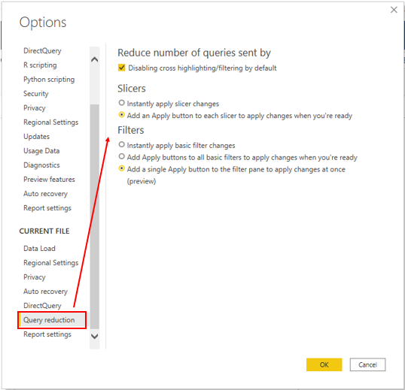
Optimize Performance
Steps to optimize:
Performance Analyzer
Data Source
Query Reduction
Notes:
You can examine the queries that are being sent to the underlying source and try to identify the reason for the poor query performance. You can then make changes in Power BI Desktop and the underlying data source to optimize overall performance.
Optimize data in power bi desktop: When you have optimized the data source as much as possible, you can take further action within Power BI Desktop by using Performance analyzer, where you can isolate queries to validate query plans.
Optimize the underlying data source: Your next stop is the data source. You need to tune the source database as much as possible because anything you do to improve the performance of that source database will in turn improve Power BI DirectQuery.
Customize the Query reduction options: Power BI Desktop gives you the option to send fewer queries and to disable certain interactions that will result in a poor experience if the resulting queries take a long time to run. Applying these options prevents queries from continuously hitting the data source, which should improve performance.

Slide 18
Review Questions (1)
Q01 – Which Power BI option gives you the option to send fewer queries and disable certain interactions?
A01 – Query reduction.
Q02 – Other than Power BI, another place for performance optimization can be performed is where?
A02 – At the data source
Q03 – Is it possible to create a relationship between two columns if they are different DATA TYPE columns?
A03 – No, both columns in a relationship must be sharing the same DATA TYPE.

Slide 19
Module Overview
We covered the following concepts:
Data model performance optimization
DirectQuery model optimization
Notes:
In this module we discussed:
How to optimize the data model for performance
How to optimize DirectQuery models

Slide 20

References
PL-300 Optimize a model for performance in Power BI
https://docs.microsoft.com/en-us/learn/modules/create-measures-dax-power-bi/
Notes:
It is good practice to tie back your ILT deliveries to role-based learning materials on Microsoft Learn. What is listed here should supplement your delivery and the role-based training your course is affiliated with. It is important to give the learners continued education opportunities for growth.
Steps:
1. Insert the page title here along with the url to other Microsoft resources
2. It is only necessary to duplicate this slide if there are more than 6 references that need to be shared with the students.

